Slide 1
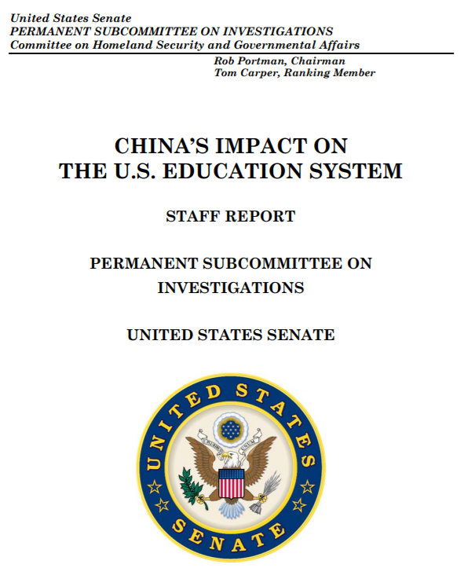


Foreign Donations
to US Universities
2012-2018
Matt Chan
The Data Incubator
Data Science Training Program
Project Proposal
https://github.com/thewchan/US-HigherEd_Foreign_Donations

Slide 2
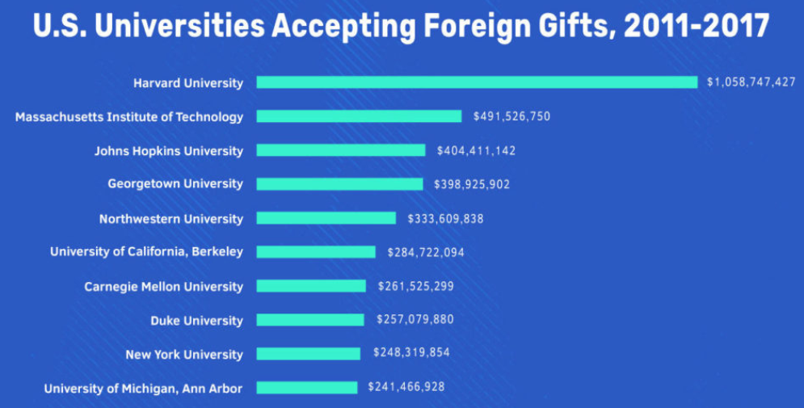
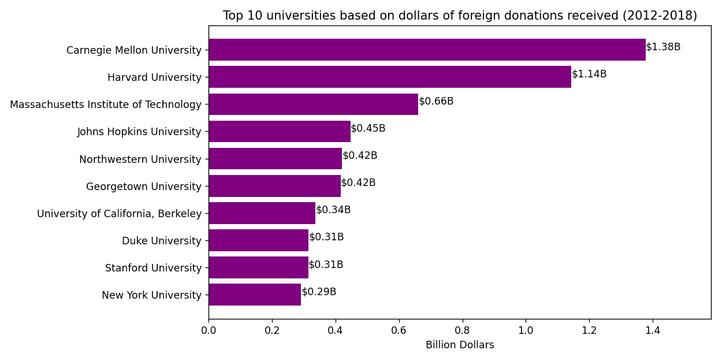

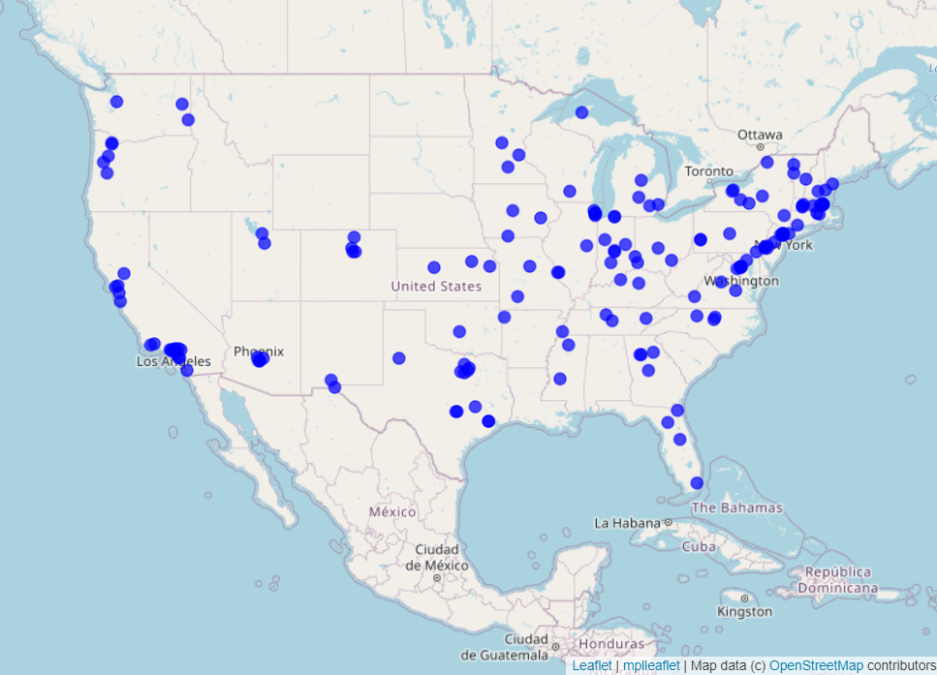
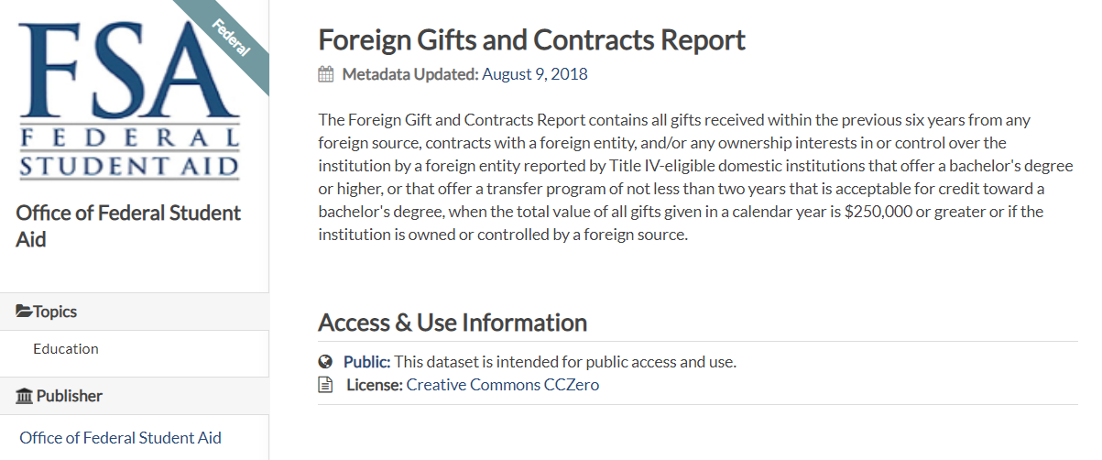

Slide 3
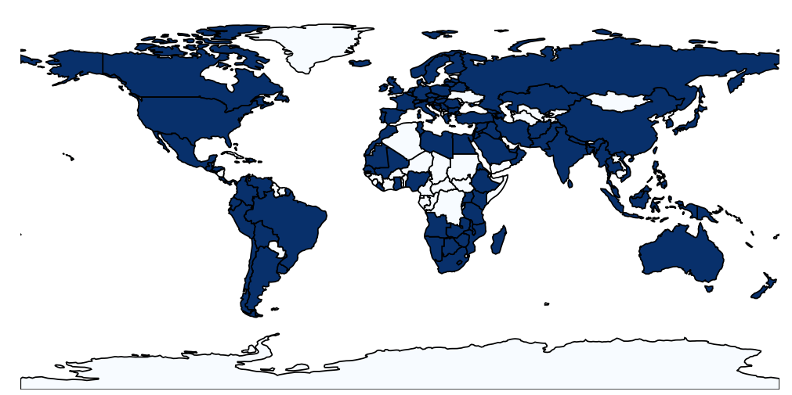
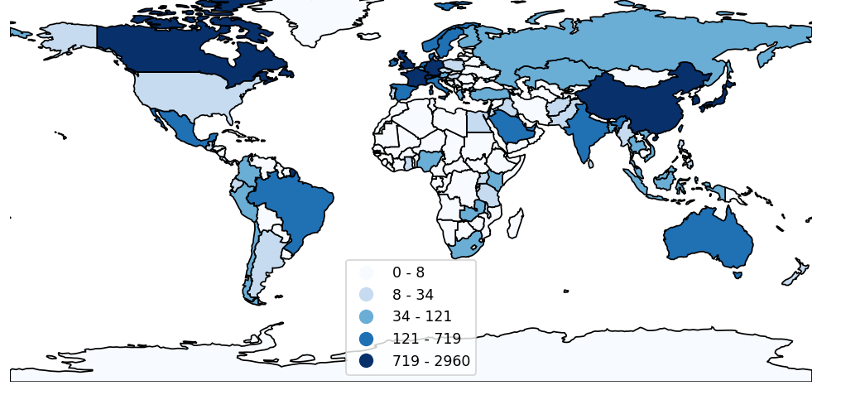
Countries that donated to US universities
Vs.
Number of Donations made by countries

Slide 4
